Slide 1
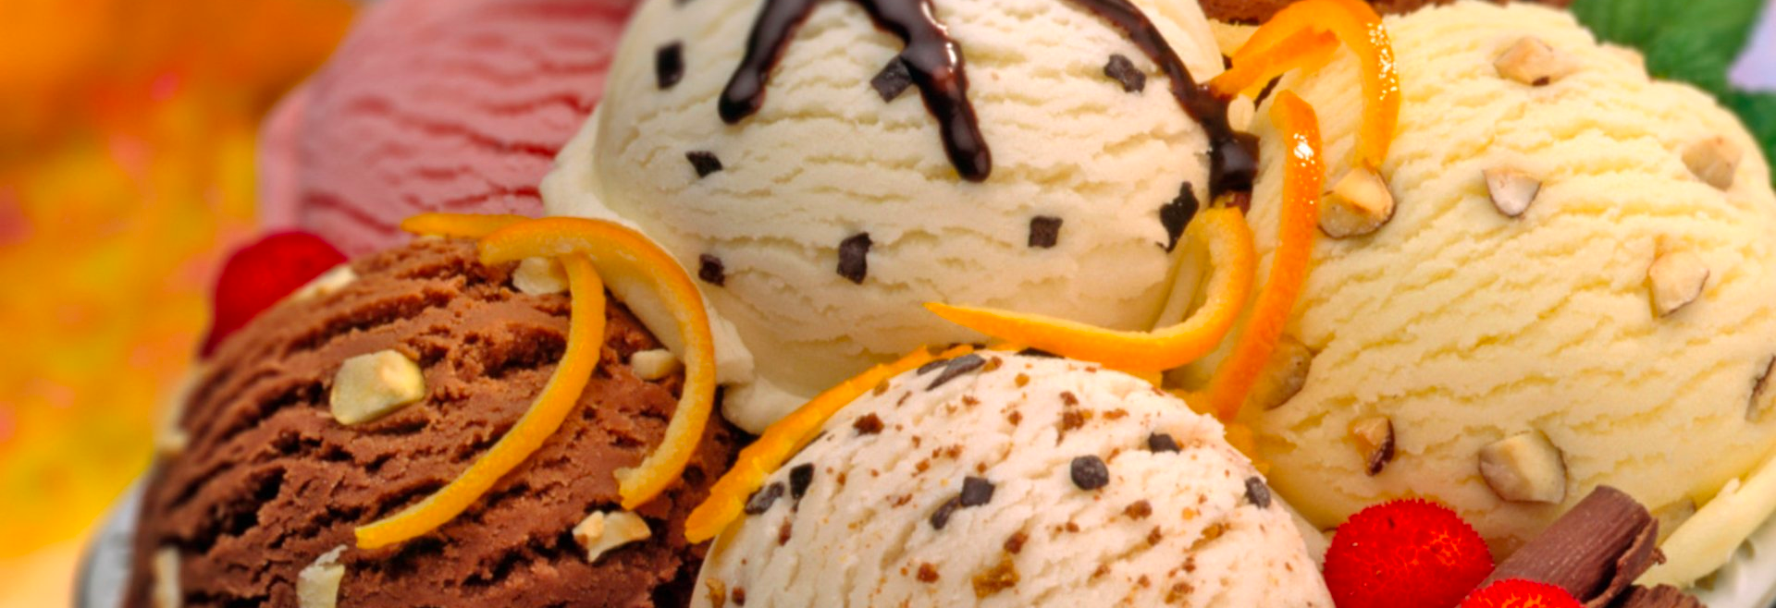
Yelp Reviews on Ice-cream Shops
STAT 628, Module 3
Group3: Ke Chen, Nan Yan, Chen Hu, Richard Yang

Slide 2
Goals
To find influencing factors of success for ice cream shops
To provide recommendation for customers
Most popular shop, flavor, topping in a city
To construct score-prediction model for shop owners
How can an existing shop improve its score
How should a ‘startup’ arrange its facilities

Slide 3
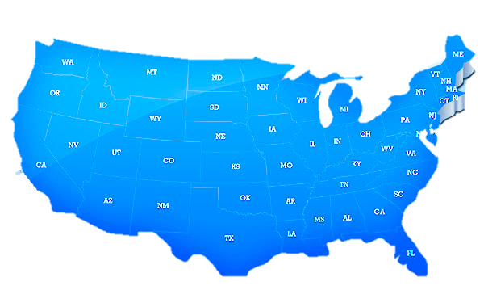

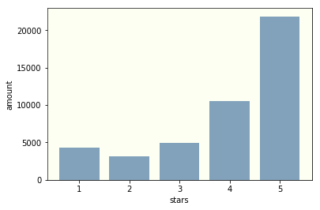
Dataset
455 ice cream shops with 45k reviews
6 target cities in the U.S.:
Las Vegas, Phoenix, Charlotte, Pittsburgh, Madison
Score distribution
Mean score: 3.95 (Pretty high)
Median score: 4

Slide 4
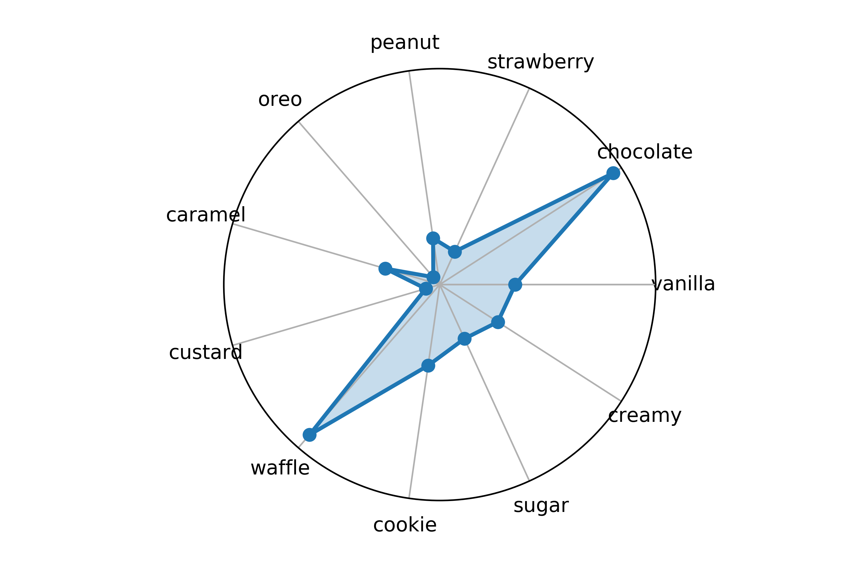
Review Analysis of Flavor
Popular Flavor
Word frequency analysis
Decision Tree: choose word with more power of distinguishing scores of reviews
People talk more often about these flavors indicating they order them most and concern more about their taste
Flavor Recommendation
Favorable Rate: word frequency in positive reviews (score = 4, 5)
Make comparisons among each cities
E.g. We recommend people to try chocolate and waffle in Pittsburgh
Word Cloud of Flavor
chocolate
waffle
Favorable Rate in Pittsburgh

Slide 5
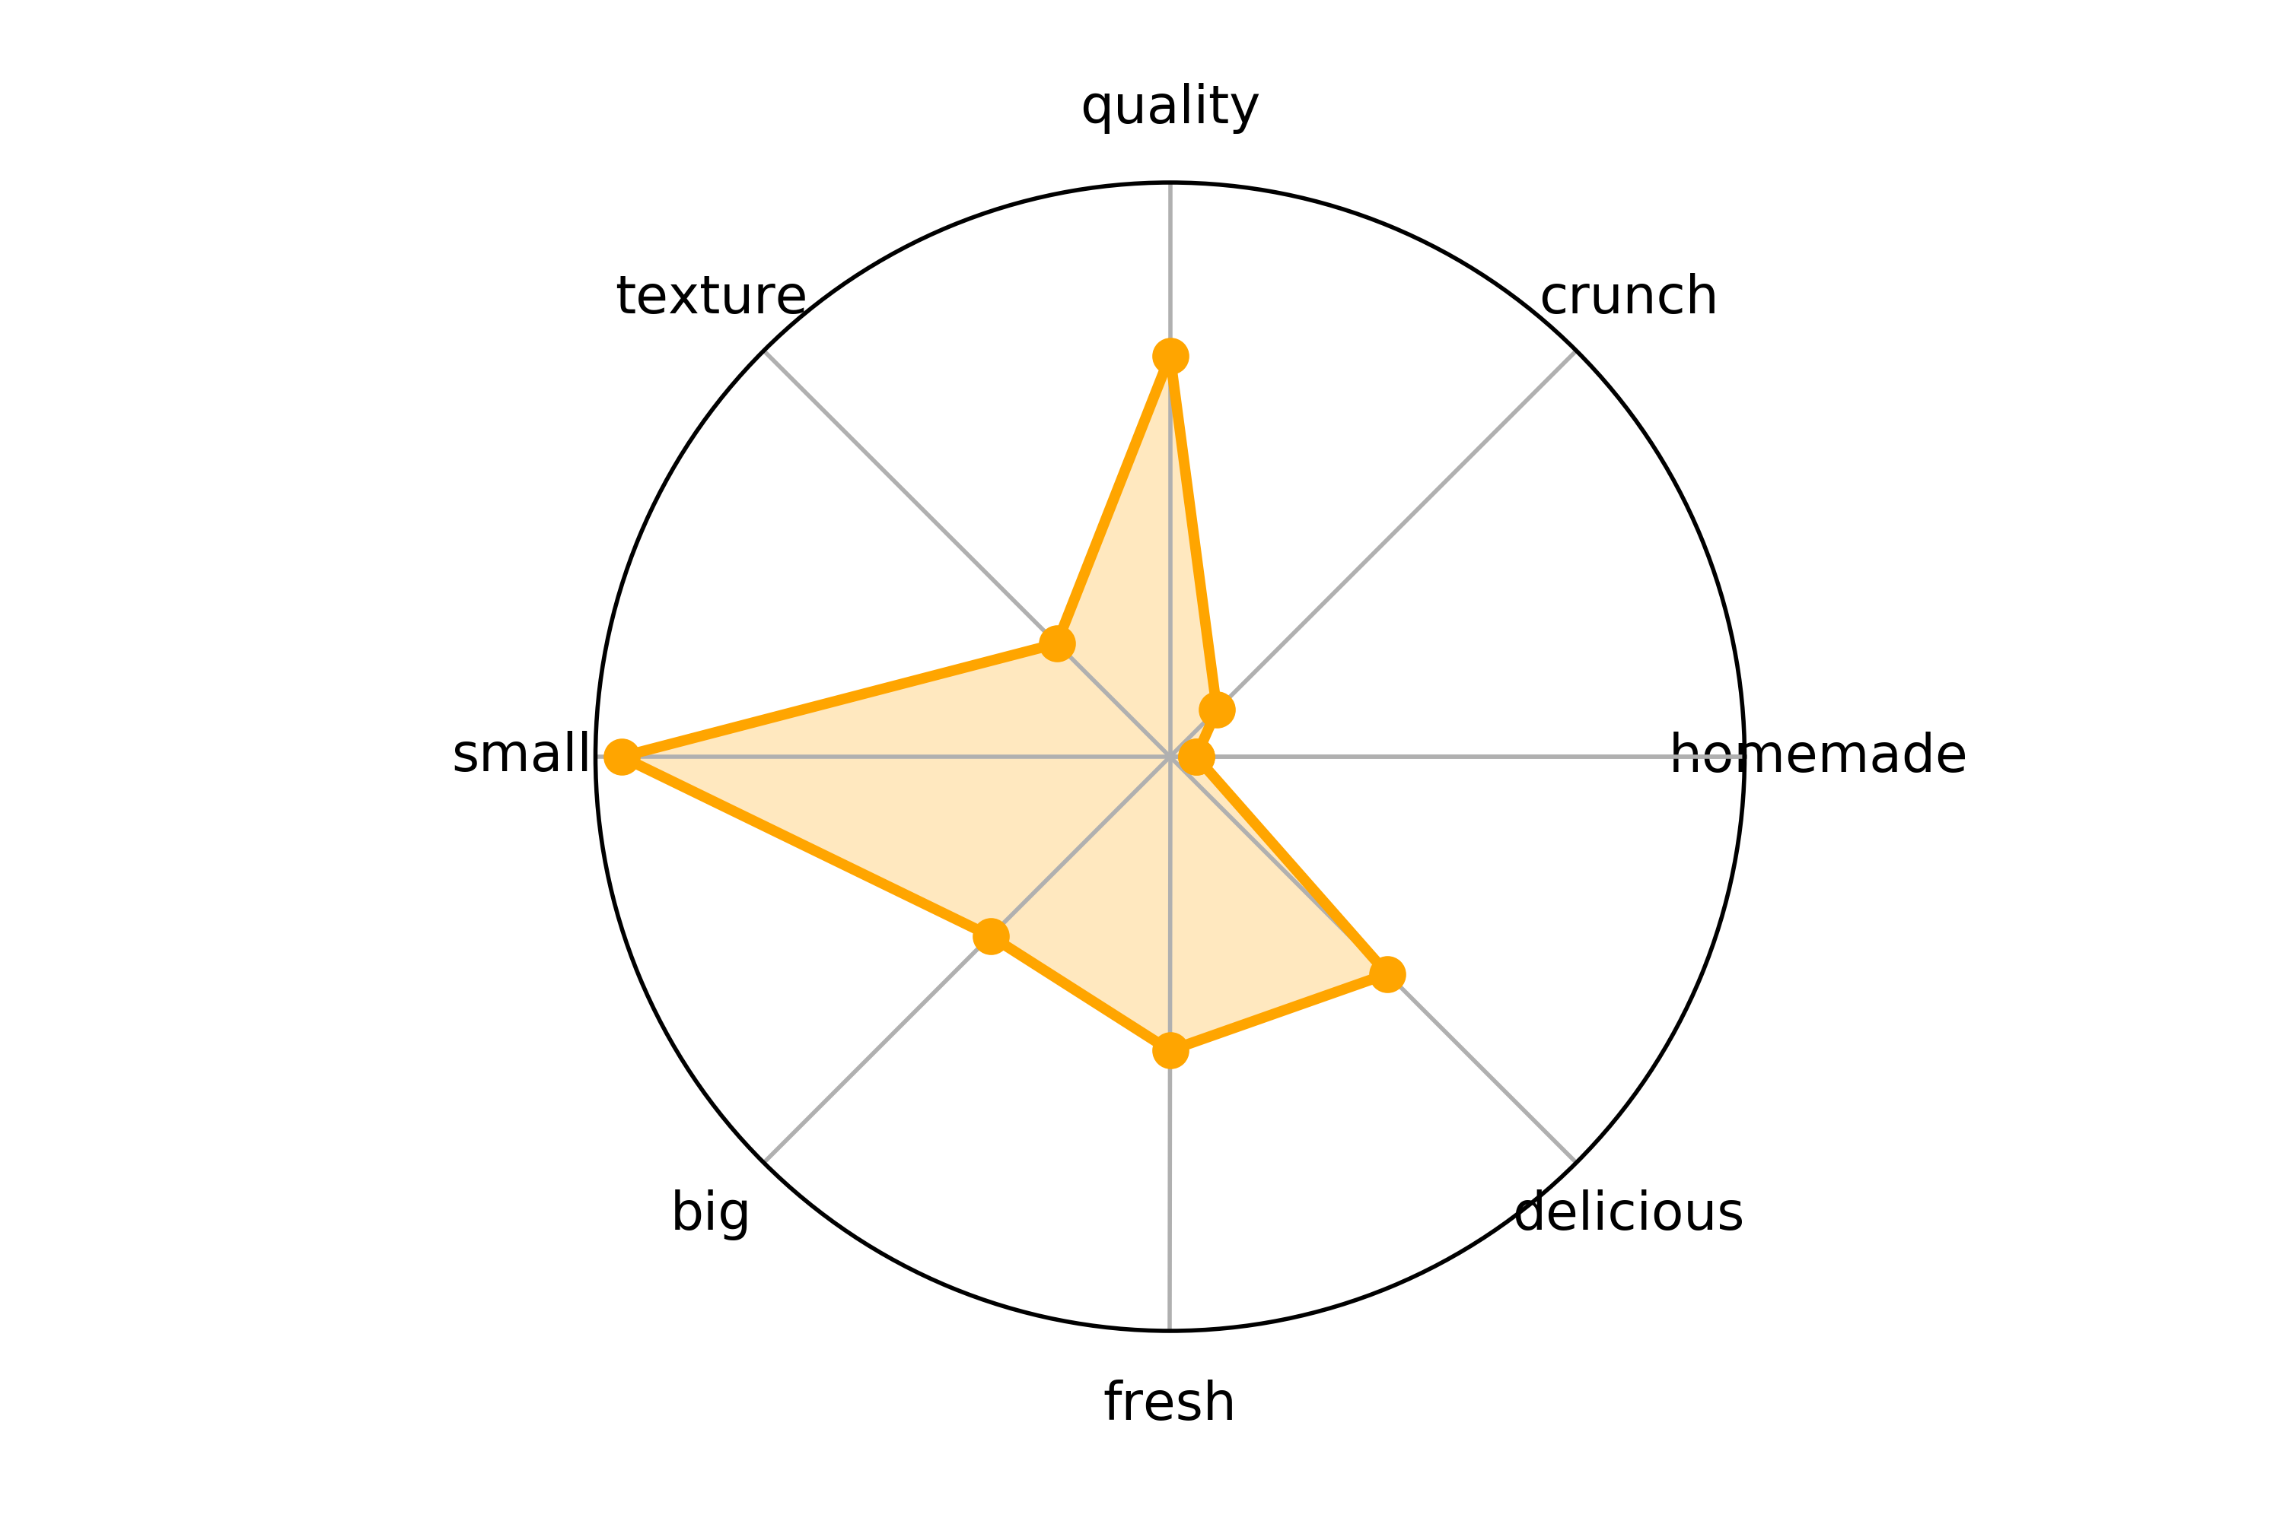
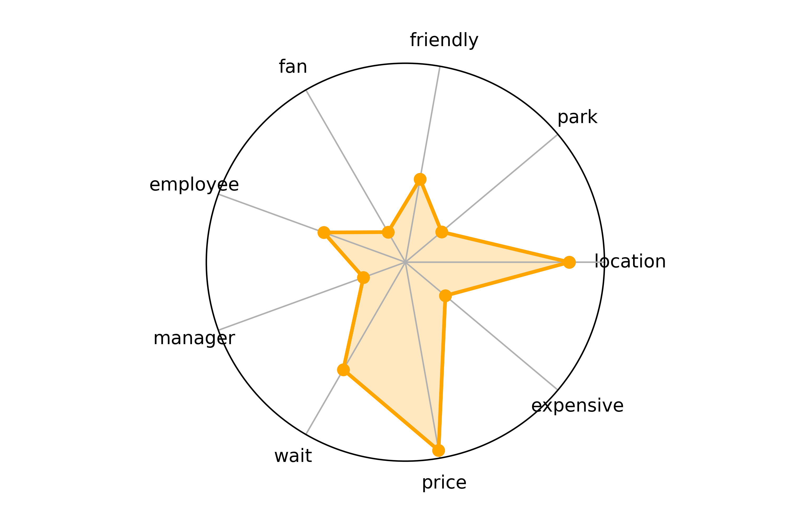
Review Analysis of Property & Service
Improvement Advice
Most frequent words of property & service in negative reviews (score = 1,2,3)
e.g. Advice for Shops in Madison
Ice cream property: size, quality, freshness, taste
Shop service: price, location, waiting time
Negative Comment of Property
Negative Comment of Service

Slide 6
Score Prediction
Response：re-computed business stars based on users’ weight
Covariates: business attributes (many missing values and categories)
Model: multivariate linear regression

Slide 7
Users’ Faithfulness Prediction
Goal: Avoid biased/false/extreme reviews, obtain more accurate weighted mean of score for each shop
Model: Logistic Model to predict the probability of being a faithful user
Dependent Variable: “elite” status (entitled by Yelp
Independent Variable: # fans, # friends, # useful, etc.
Provide reviews from faithful users with higher weight

Slide 8
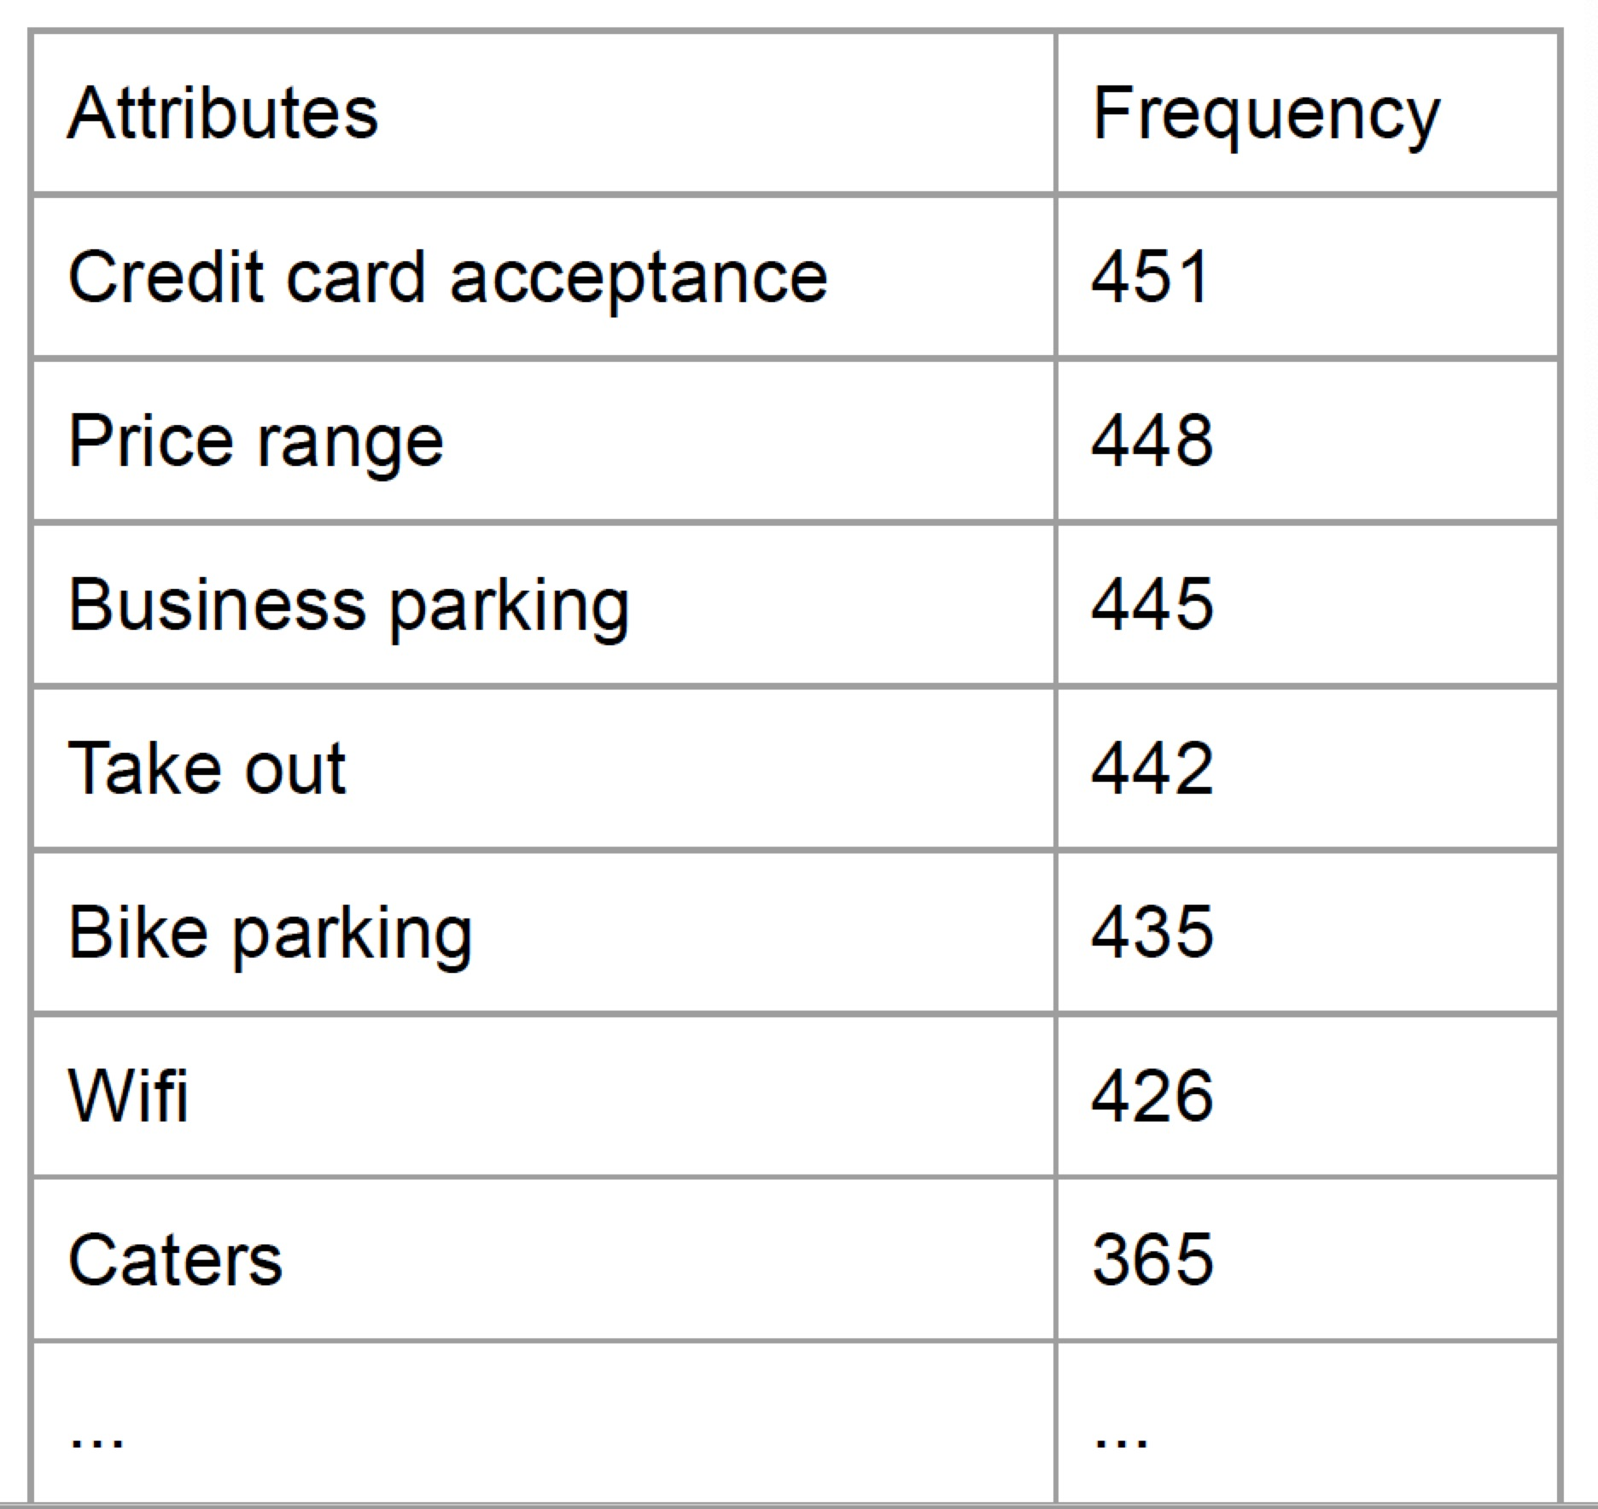
Missing value in attributes
Dropping variables: If frequency < 100.
Randomly replace NA with values proportionally to not NA values: If t-test for testing mean stars of shops provide this attribute equal to that of shops don’t provide it is not significant.
Impute NA by KNN with predictors ‘stars’ and ‘review count’ : If t-test for testing mean stars of shops provide this attribute equal to that of shops don’t provide is significant.
Notes:
Assign NA randomly with different values in proportion with known sample distribution of this attribute

Slide 9
Reduce categories in attributes
Merge some categories: If Tukey test to test difference in pairwise categories is not significant
Cut continuous variables into categorical: seek optimal cut points for open time, close time and business time.
Notes:
Assign NA randomly with different values in proportion with known sample distribution of this attribute

Slide 10
Score Prediction
Linear model: predict the score of a shop given attributes it have
(continuous response)
Round the predicted stars to integer , ‘misclassification rate’ is 31%
Classification tree model: (categorical response) , ‘misclassification rate’ is 29%
Linear model is more interpretable

Slide 11
Conclusion
Attribute | coefficient | Attribute | coefficient | Attribute | coefficient
Las Vegas | 3.51 | Takeout | 0.25 | Good for group | -0.35
Cleveland | 3.97 | Quiet | 0.16 | Weekday close after 11 | -0.10
Madison | 3.46 | reservation | 0.01 | Weekend close after 11 | 0.28
Charlotte | 3.37 | Wheelchair | 0.01 | Weekend business time last over 11h | 0.25
Pittsburgh | 3.74 | Credit card | 0.04 | Bikeplace | -0.1
Phoenix | 3.44 | Delivery | 0.24

Slide 12
Suggestions:
It is unnecessary to have caterings nor TVs
The shops shouldn't be too noisy, thus noisy group activities should not be allowed.
Basic service such as reservation, wheelchair, take out, delivery, credit card acceptation are expected to provide
It is better to close after 11:00 pm at weekend while it is not necessary to do so at weekdays
Fresh, creamy ,different sizes ice cream are recommended.
Short waiting time, well-trained stuffs and good location are crucial for getting higher stars

Slide 13
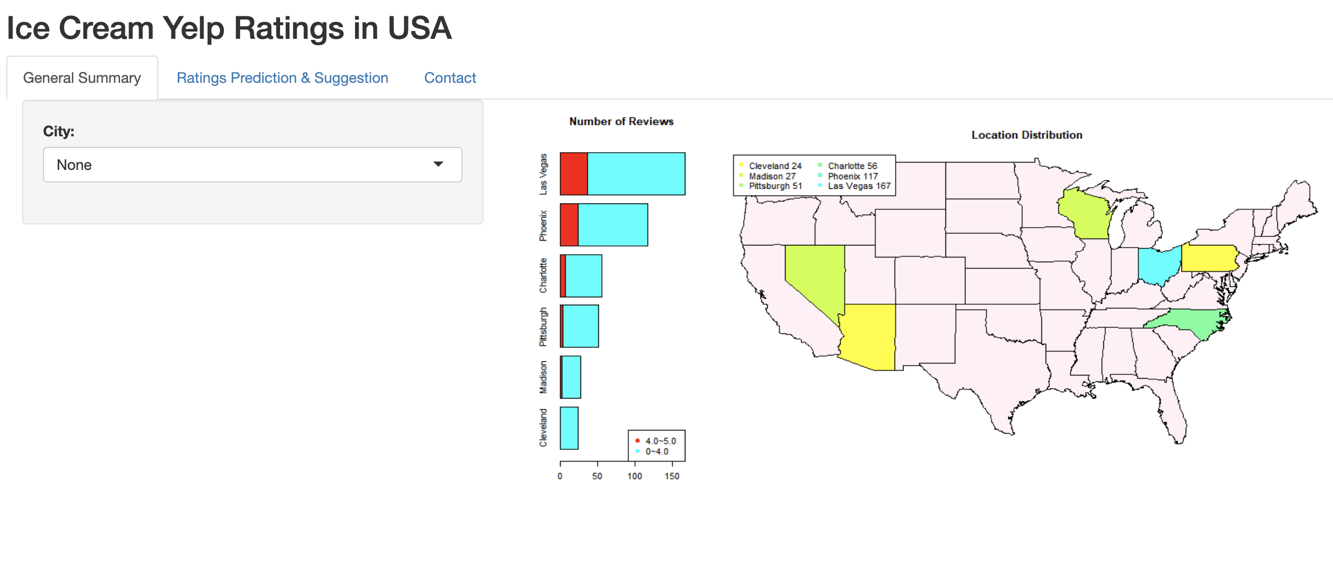
Conclusion (Shiny App)
Map of target cities
Number of reviews for each cities
Positive reviews vs. negative reviews (shops in southern part has higher score)

Slide 14
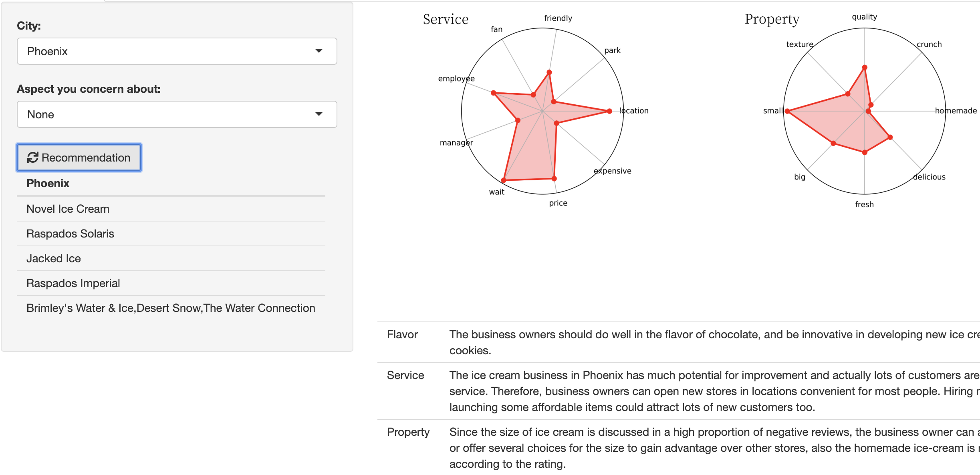
Conclusion (Suggestions)
Flavor: The business owners should do well in the flavor of chocolate and be innovative in developing new ice cream accompanied by cookies.
Service: The ice cream business in Phoenix should pay attention to service. Owners can open new stores in locations convenient for most people. Hiring more staff and launching some affordable items could attract lots of new customers too.
Property: Since the size of ice cream is discussed in a high proportion of negative reviews, the business owner can advertise their big size or offer several choices for the size to gain advantage over other stores, also the homemade ice-cream is popular according to the rating.
Shops that you should never miss!!!

Slide 15
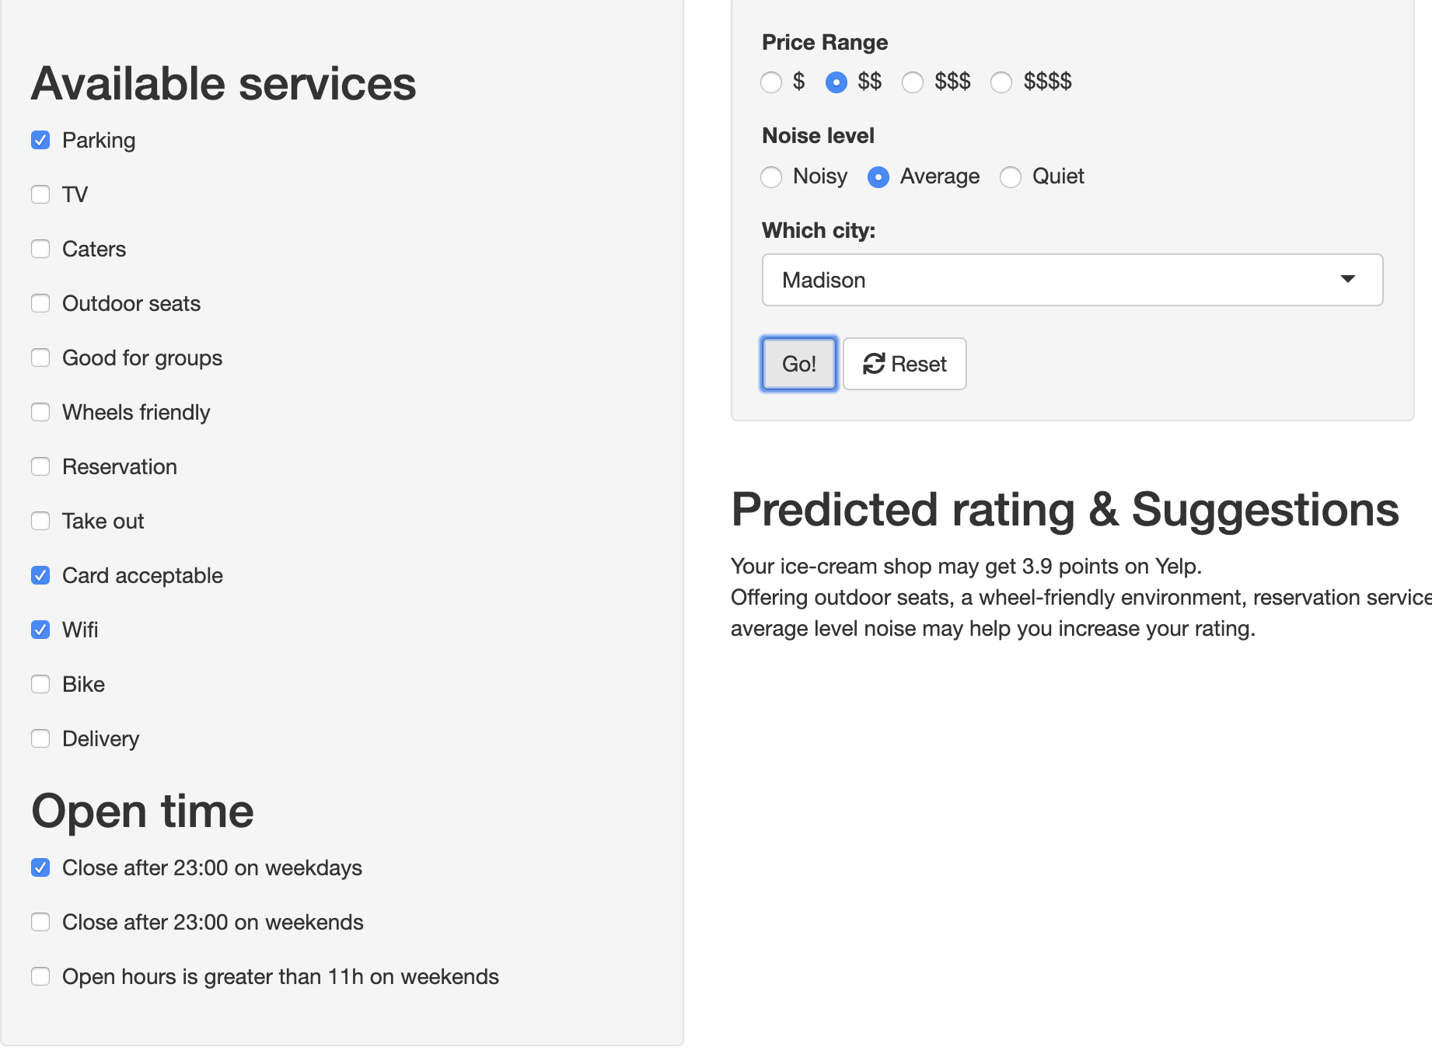

Conclusion (Star prediction)
Predicted rating: 3.9
Suggestions: Offering outdoor seats, a wheel-friendly environment, reservation service, take-out service, delivery service, lower price, an environment with average level noise may help you increase your rating.

Slide 16
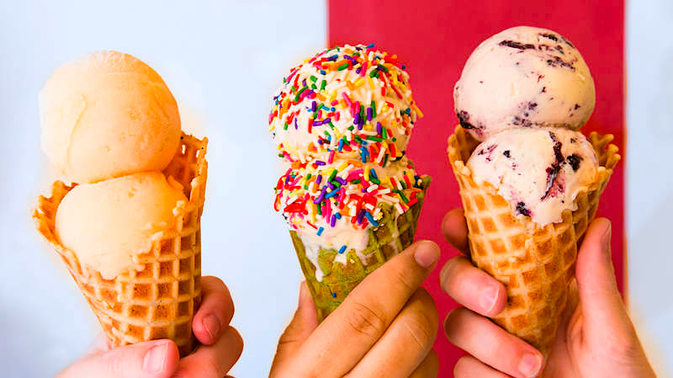
THANKS Q & A

